Slide 1
Change Management
SE423: Software Project Management

Slide 2
Outline
Change Control
Software Maintenance
Other Aspects
Summary

Slide 3
Change Control

Slide 4
Software Change
Software change is inevitable
New requirements emerge when the software is under development or being used
The business environment changes
Errors must be repaired, Risks mitigated
New equipment must be accommodated
The performance or reliability may have to be improved
A key problem for organizations is implementing and managing change to their current projects and legacy systems

Slide 5
Integrated Change Control
Integrated Change Control is a process concerned with project change requests
The process is carried out from project inception through completion
All changes must be carefully controlled to maintain the integrity and consistency of the project plan
Change control encompasses review, evaluation, approval/rejection, and managing and coordinating approved changes

Slide 6
Integrated Change Control
Recognizes that projects will often require changes to the established project plan
All changes must be carefully controlled to maintain the integrity and consistency of the project plan
Integrated change control encompasses all aspects of change to the project:
Reviewing and approving requested changes
Managing the changes when they actually occur
Controlling elements of the project management plan (scope, cost, budget, schedule, and quality) in response to changes
Controlling changes to requirements, design, code and documentation.

Slide 7
Change or Configuration Control
Configuration Management Plan
Change & Version control
Items:
Code (source for product)
Documents: requirements, design, test plans, user guides
Plans and databases (MS project, etc.)
Scripts for testing
Scripts for infrastructure
Software development plan and other process documents

Slide 8
Integrated Change Control
In some projects, the Integrated Change Control process includes a change control board (CCB)
The CCB is a formally chartered group responsible for reviewing, evaluating, approving, delaying, or rejecting changes to the project, and for recording and communicating such decisions
Note that changes have a potentially greater impact in CPM scheduling:
Changes on the critical path have greatest impact while those off the critical path have less
Changes in CCM scheduling require adjustments to buffers
The same responses to change are needed, but the impact to the schedule may be less severe than in CPM

Slide 9
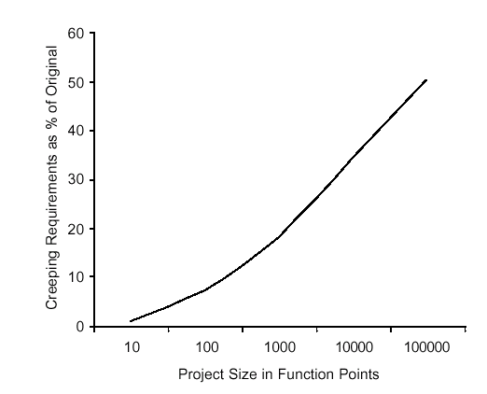
Change Control
Average project has 25% requirements change
Overly detailed specs. or prolonged requirements phase are not the answer
Sources of change
Change control is a process
Change Control Board (CCB)
Structure, process, triage

Slide 10
Control the Change – I
Need for change is recognized
Change request is submitted as a “request for change” (RFC) or engineering change order (ECO)
Developer or PM team evaluates: impact and desirability
Change report is generated
Change control authority (CCB) makes a decision to either:
Deny request.
Change request is denied
User is informed
Proceed
If change is approved:
Request is queued for action. ECO (Engineering Change Order) is generated.
Individuals assigned to configuration objects.
Objects checked out and change made.
Change audited.
Baseline established.
If it is a Software Configuration Item (SCI)
Perform SQA and testing activities
Check-in the changed objects

Slide 11
Control the Change – II
For Software Configuration Items (SCI)
Promote SCI for inclusion in next release
Rebuild appropriate version
Include all changes in release
Review/audit the change
Perform Verification and Validation [testing activities]
Distribute new version

Slide 12
Control the Change – III
Use a change management system (COTS) and a change tracking system.
Ideal if they are integrated: aka Comprehensive Software Change Management
SCM (Source code management)
Issue/defect tracking software

Slide 13
Agile Perspective (Integrated change control)
The agile change control process is not controlled by a change review board and the project manager
Product changes are owned and managed by the customer
Process changes are owned by the team
The project manager facilitates collaborative discussion of changes between the customer and the team
Integrated Change Control maps to ‘continuous backlog management’ in an agile project

Slide 14
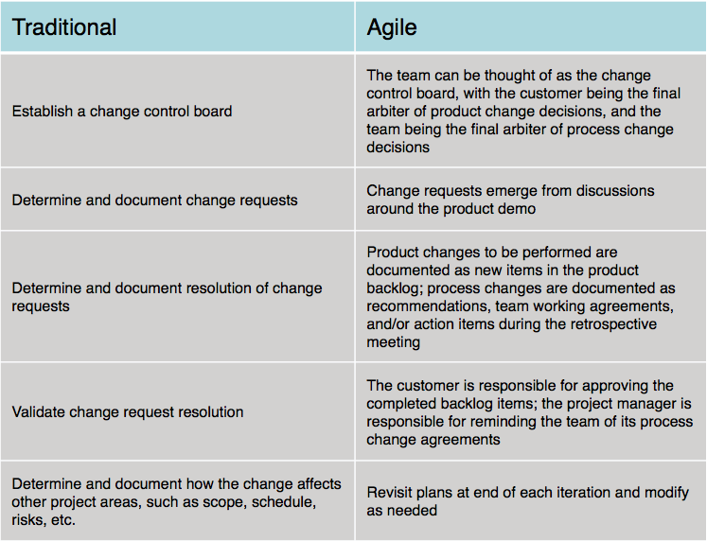
Summary Comparison

Slide 15
Change During Development
Sometimes change occurs during development that necessitates changes in scope
Approval of CCB (Change Control Board) and
Requires extensive planning
May require more time/resources (project triangle)
Plan-driven methodologies may or may not have this built in (i.e. Spiral) or may be specifically built to resist change (i.e. Waterfall)
Agile Methodologies embrace change
Scrum allows for change to the Product Backlog at any time, but manages risk by freezing the current Sprint Backlog
Stakeholder Communication IS KEY

Slide 16
Software Change Strategies
Software maintenance
Changes are made in response to changed requirements but the fundamental software structure is stable
Architectural transformation
The architecture of the system is modified generally from a centralized architecture to a distributed architecture
Software re-engineering
No new functionality is added to the system but it is restructured and reorganized to facilitate future changes
These strategies may be applied separately or together

Slide 17
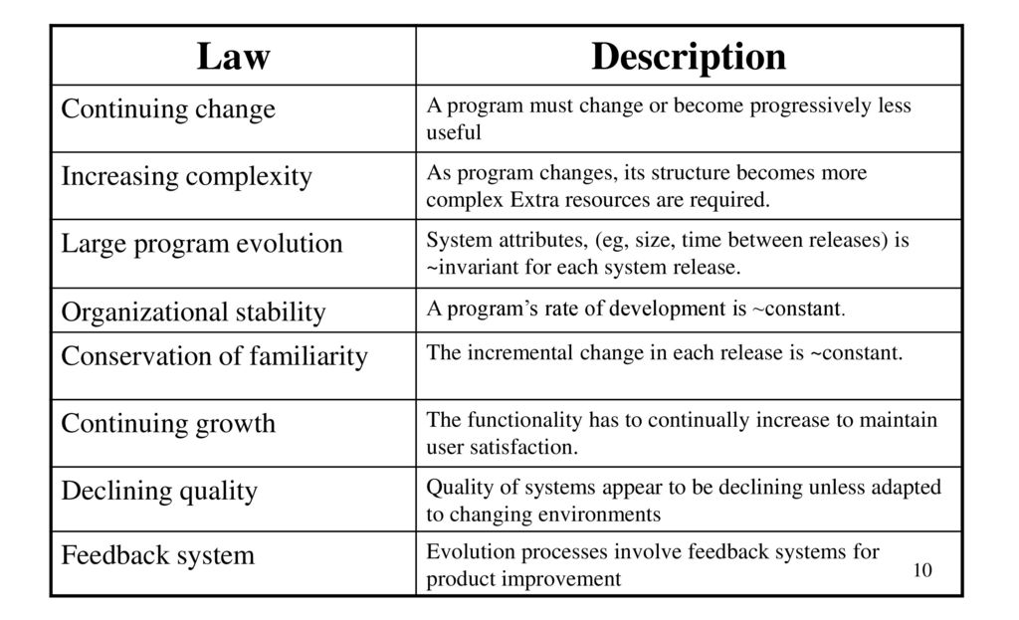
Lehman’s Laws

Slide 18
Applicability of Lehman’s Laws
This has not yet been established
They are generally applicable to large, tailored systems developed by large organizations
It is not clear how they should be modified for
Shrink-wrapped software products
Systems that incorporate a significant number of COTS components
Small organizations
Medium sized systems

Slide 19
Software Maintenance

Slide 20
Software Maintenance
Modifying a program after it has been put into use
Maintenance does not normally involve major changes to the system’s architecture
Changes are implemented by modifying existing components and adding new components to the system

Slide 21
Maintenance is Inventible
The system requirements are likely to change while the system is being developed because the environment is changing. Therefore a delivered system won't meet its requirements!
Systems are tightly coupled with their environment. When a system is installed in an environment it changes that environment and therefore changes the system requirements.
Systems MUST be maintained therefore if they are to remain useful in an environment

Slide 22
Types of Maintenance
Maintenance to repair software faults
Changing a system to correct deficiencies in the way meets its requirements (Corrective Maintenance)
Maintenance to adapt software to a different operating environment
Changing a system so that it operates in a different environment (computer, OS, etc.) from its initial implementation (Adaptive Maintenance)
Maintenance to add to or modify the system’s functionality
Modifying the system to satisfy new requirements (Perfective Maintenance)

Slide 23
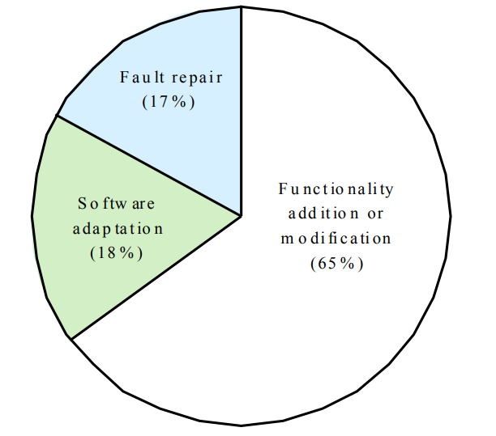
Distribution of Maintenance Efforts

Slide 24
Maintenance Cost
Usually greater than development costs (2* to 100* depending on the application)
Affected by both technical and non-technical factors
Increases as software is maintained. Maintenance corrupts the software structure so makes further maintenance more difficult.
Ageing software can have high support costs (e.g. old languages, compilers etc.)

Slide 25
Maintenance Cost Factors
Team stability
Maintenance costs are reduced if the same staff are involved with them for some time
Contractual responsibility
The developers of a system may have no contractual responsibility for maintenance so there is no incentive to design for future change
Staff skills
Maintenance staff are often inexperienced and have limited domain knowledge
Program age and structure
As programs age, their structure is degraded and they become harder to understand and change

Slide 26
Evolutionary Software
Rather than think of separate development and maintenance phases, evolutionary software is software that is designed so that it can continuously evolve throughout its lifetime
YES, but how/much?

Slide 27
Maintenance Prediction
Maintenance prediction is concerned with assessing which parts of the system may cause problems and have high maintenance costs
Change acceptance depends on the maintainability of the components affected by the change
Implementing changes degrades the system and reduces its maintainability
Maintenance costs depend on the number of changes and costs of change depend on maintainability

Slide 28
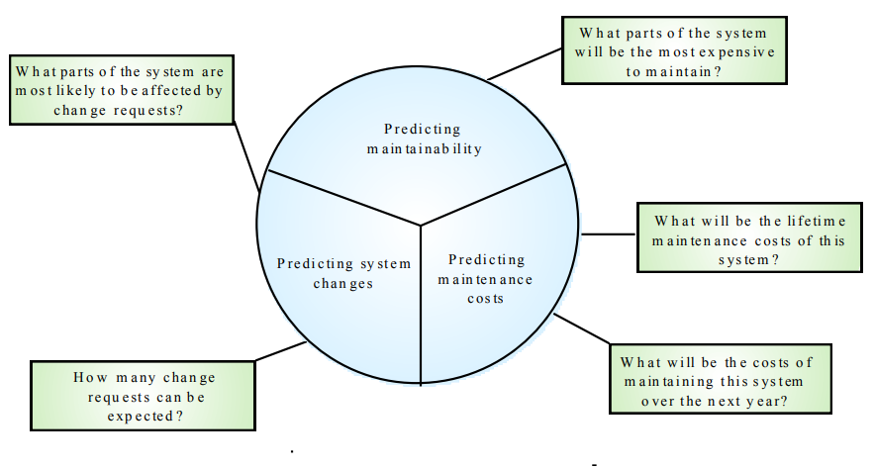
Maintenance Prediction

Slide 29
Change Prediction
Predicting the number of changes requires an understanding of the relationships between a system and its environment
Tightly coupled systems require changes whenever the environment is changed
Factors influencing this relationship are
Number and complexity of system interfaces
Number of inherently volatile system requirements
The business processes where the system is used

Slide 30
Complexity Metrics
Predictions of maintainability can be made by assessing the complexity of system components
Studies have shown that most maintenance effort is spent on a relatively small number of system components
Complexity depends on
Complexity of control structures
Complexity of data structures
Procedure and module size

Slide 31
Process Metrics
Process measurements may be used to assess maintainability
Number of requests for corrective maintenance
Average time required for impact analysis
Average time taken to implement a change request
Number of outstanding change requests
If any or all of these is increasing, this may indicate a decline in maintainability

Slide 32
Architecture Evolution
There is a need to convert many legacy systems from a centralised architecture to a client-server architecture
Change drivers
Hardware costs. Servers are cheaper than mainframes
User interface expectations. Users expect graphical user interfaces (CLI->GUI)
Distributed access to systems. Users wish to access the system from different, geographically separated, computers

Slide 33
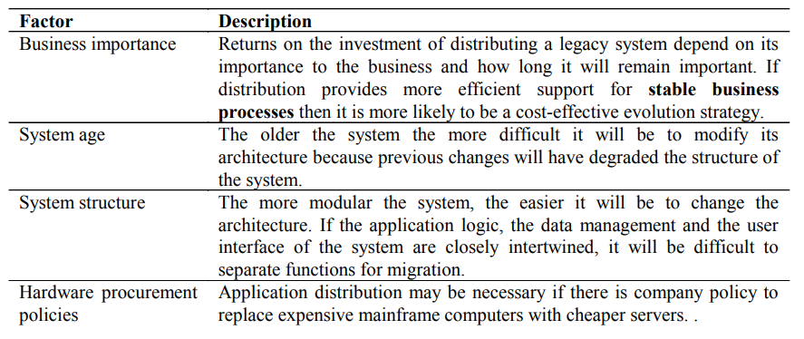
Distribution Factors

Slide 34
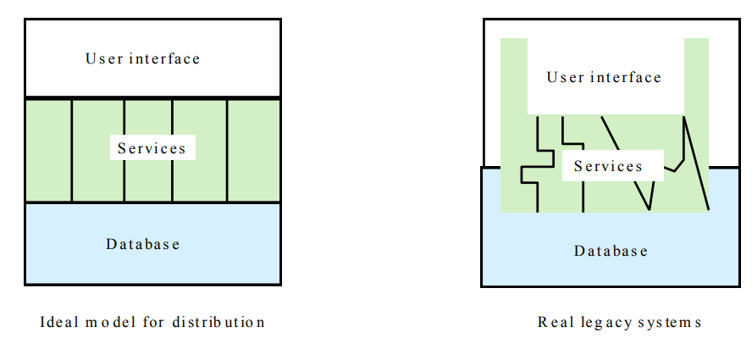
Legacy System Structure
Ideally, for distribution, there should be a clear separation between the user interface, the system services and the system data management
In practice, these are usually intermingled in older legacy systems

Slide 35
Key Points
The costs of software change usually exceed the costs of software development
Factors influencing maintenance costs include staff stability, the nature of the development contract, skill shortages and degraded system structure
Architectural evolution is concerned with evolving centralized to distributed architectures
A distributed user interface can be supported using screen management middleware

Slide 36
Other Aspects

Slide 37
Other Aspects
Roll-Out
Release Check-List
Training
More than just end-users
Users, systems ops, maintenance developers, sales
Documentation
Many types: End-user, sales & marketing, operations, design
Migration
Moving users from existing system to your new one
Maintenance and Support
We’ll discuss each of these …

Slide 38
Rollout
Create a “Release Checklist”
Avoid activities falling through the cracks
Activities by Group:
Engineering, QA, Documentation, Operations
Possibly sign-off signatures
Roll-out: Must have a plan for the process
Often on a given day (ex: a Sat.)
Must be a very detailed plan

Slide 39
Shipping Details
Packaging (if commercial product)
Marketing collateral
Security mechanisms (if commercial product)
Licensing
Plan
Mechanism

Slide 40
Installation
Scripts
Uninstall (if not Web-based)
If you need to install your software (as on PCs):
Don’t underestimate:
Time this takes to develop
Importance of a “first impression”
Or, if “custom” software you’re reselling
Installation at site is often a “mini-project”

Slide 41
Training
Often more than just end-users
Users
Sales & Marketing staff
System operators
Maintenance engineers (possibly)
Sales engineers (possibly)
(Technical) Support staff

Slide 42
Documentation
Must be ready by ship-date
Final user documentation
On-line help
Updates to other
Operations documentation
Development documentation
Sales and marketing material
Web site
Test reports
Release notes

Slide 43
Migration
Migration is the process of moving from the old application/system to the new
Migration Plan
Back-out Plan
Data Conversion

Slide 44
Migration Plan
Includes
Description of environment (computers, DBs, interfaces)
Description of existing data needed
Description of operational constraints (ex: when can we move to the new system? Weekends only? Last week of month only?)
List of affected organizations and contacts
Plan of steps to be taken
Does it require a service interruption?
If so, when does this happen? A weekend?
Training?
Is there a help-desk?
If so, do they have “scripts” or new material?

Slide 45
Migration Strategies
Communication with customers is crucial
Importance of 2-way communication
What is happening, when, and why
“Why” should remind them of the benefits
Not too much detail or too little
Where do customers go for more information?
Minimize intrusiveness
Find-out about customer’s key dates
When does the system absolutely need to be stable?
Know about their important deadline dates
They must buy-into the approach!

Slide 46
Migration Strategies
Considerations:
Level of business disruption
Degree of latitude in “production” date
How much internal opposition to system is there?
If higher, perhaps a longer ‘adjustment’ period
Your comfort level of system quality
If questionable, may want to mitigate risk

Slide 47
Migration Strategies
Flash-Cut migration
Straight-move from old system to new
Immediate Replacement
Fastest approach
Still want a back-out plan
Requires strong planning and testing
Parallel Operation
Mitigates risk
Parallel to either existing manual or system process
Cut occurs once new system “burned-in”
Staged migration
Replace one part of existing system at a time

Slide 48
Flash-Cut
Immediate Replacement
Ex: new corporate-wide calendar system
Requires very careful planning & testing
Still try to get some users to “try” it first if possible
Develop a back-out plan

Slide 49
Cutover
Criteria: What conditions must be met prior?
Responsibility: Who decides?
Operations: Who ‘owns’ it once it’s live?
Rehearsals: Sometimes used.

Slide 50
Back-Out Plan
Especially important for “conversions”
Customers already have expectations and needs as defined by their existing system
Must be able to restore customer’s service ASAP
May mean running both simultaneously “just in case”
Leave it in place for awhile (more than a day!)
When to fall-back?
Mgmt: sooner, Tech: one-more-fix
Set a time limit (ex: 3 hours of start)
Data recovery and migration back to old system

Slide 51
Data Conversion
Most systems need this step
Most PMs forget this
Impacts both completely new and replacement systems
The “data” often more valuable than the “system”
Data Conversion Areas
Data Sources:
Where does it come from?
Do you need to modify data on the way in?
Is it accurate?
Process Controls:
Does it happen all at once?
How do you guarantee it’s been done correctly?
Completion:
How do you handle any ‘exceptions’?
Do you make backups? Can you restart?

Slide 52
Parallel Operation
Multiple variations of this method
An “adoption” period
See telephone industry with new area codes
Both work for a period of time
Strategies
Avoid flash-cuts if possible
Start with test subjects

Slide 53
Concluding Software Projects
Seems simple, often isn’t
Potential Issues
Last-minute change requests
“One more feature”
Disputes of fulfillment of all requirements
Often “interpretation” issues
Keeping the team motivated
Difficult transition to maintenance

Slide 54
Maintenance Phase
Need a support plan and a maintenance plan [should be part of project plan]
The “No respect” phase
Less “glamorous”
Lack of enthusiasm
Pressure to make fixes quickly
For “production” problems
Software can become “hacked” “patchwork” over time
Finding a support & test platform can be difficult
Often the forgotten child until fixes are needed

Slide 55
Maintenance Phase
Compare to hardware maintenance
Not to keep state same; but changes to state
Fixes and enhancements
Configuration control is very important
Fixing the “right” version; tracking branches
Project management not always carried over
Smaller team
Often not a ‘dedicated team’
Drawn from developers with other main tasks

Slide 56
Maintenance Phase
Contracts, remember those?
Always consider the maintenance phase here
Often via a “labor hours” contract
Time & materials in a “direct” scenario
Otherwise via “maintenance contract”
Percentage of software license fee
Ex: 20% of original cost per year
Corp. budget if internal/IS projects
Often annual/monthly “maintenance” allocations

Slide 57
Project in Trouble
“What if the project cannot meet the schedule?”
Level with the sponsor
Move some features/requirements to a second phase
Use Resource Leveling Techniques
Fast tracking – two activities in parallel
Activity shifting – Move start/end dates forward or backward
Activity splitting – Break an activity into two or more pieces
Activity stretching – Use less of a given resource continuously
Resource substitution – Assign a different resource
Allocating overtime – Work resources longer
Re-evaluate tasks: effort and need

Slide 58
Project Recovery
How to save a “drowning project”
3 Approaches
Cut the size of the software
Increase process productivity
Slip the schedule, proceed with damage control
Opportunity for decisive leadership action
Not a time to ‘just cut corners’
Be realistic (not foolish)
Timing: politically important
Not too early, not “too” late

Slide 59
Project Recovery
First Steps
Assess situation
Is there a hard deadline, what’s negotiable, etc.
Don’t do what’s been done already
Ask team what needs to be done
People Steps
Morale; focus; re-assign
Restore morale
Sacrifice a sacred cow [See note]
Dress code, off-site, catered meals, etc.
Cleanup personnel problems
Focus people’s time
Remove non-essential work
Reassign tasks and responsibilities
Notes:
Sacrifice a sacred cow
This really does sound like a manifestation of the Hawthorne Effect - it's a short duration change to the worker environment, it enhances productivity because the worker is 'getting something special' - and since it's happening during a crisis the short duration of the effect works well within the scenario.
"...But Mayo says it is to do with the fact that the workers felt better in the situation, because of the sympathy and interest of the observers. He does say that this experiment is about testing overall effect, not testing factors separately. He also discusses it not really as an experimenter effect but as a management effect: how management can make workers perform differently because they feel differently. A lot to do with feeling free, not feeling supervised but more in control as a group. The experimental manipulations were important in convincing the workers to feel this way: that conditions were really different. The experiment was repeated with similar effects on mica splitting workers..."
In any event, hoisting the jolly roger might be going a bit too far (for you Mac aficionados out there).

Slide 60
Project Recovery
Process Steps
Fix classic mistakes
Inadequate design, shortchanged activities, etc.?
Create “Miniature Milestones”
Small (in day(s)), binary, exhaustive
Boosts morale: getting things done!
Track progress meticulously
Recalibrate after a short time
Manage risk painstakingly

Slide 61
Project Recovery
Product Steps
Stabilize the requirements
Raise the bar on change requests
Trim the feature set (see feature set control)
Determine priorities, cut the low ones
“Take out the garbage”
Find error-prone modules; re-design
Get to a known, stable state & build from there

Slide 62
Feature Set Control
Minimal Specification
Requirements Scrubbing
unnecessary or overly complex requirements to be removed.
Versioned Development
Effective Change Control
Feature Cuts

Slide 63
Summary
The software change management process is the process of managing changes to the project scope, schedule, or budget.
The change management process starts with change identification, where a change request is submitted and recorded.
The change is then evaluated to determine its impact on the project, including the scope, schedule, budget, and quality.
If the change is approved, it is implemented and integrated into the project plan.

Slide 64
Summary
Finally, the change is monitored and controlled to ensure that it does not have any negative impacts on the project.
Change management techniques include developing a change management plan, establishing a change control board, and communicating changes to stakeholders.
Change management plans should include the change management process, roles and responsibilities, communication and reporting, and change control procedures.

Slide 65
Summary
A change control board is responsible for evaluating and approving changes, and ensuring that changes are managed effectively.
Communication is critical to change management, and project managers should communicate changes clearly and effectively to stakeholders.
Effective change management can help ensure that changes are managed in a controlled and structured manner, minimizing the risk of negative impacts on the project.

